Slide 1
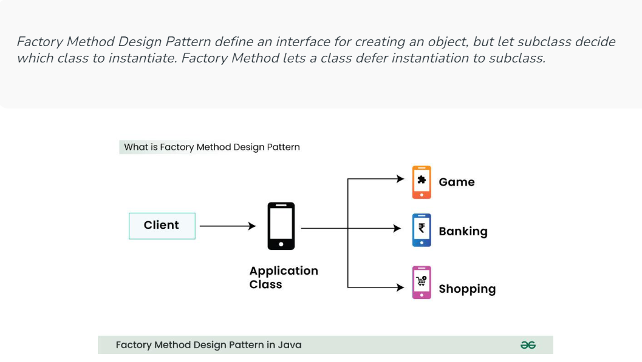
Factory Method Design Pattern

Slide 2
The factory method in the interface lets a class defer the instantiation to one or more concrete subclasses.
Since these design patterns talk about the instantiation of an object they come under the category of creational design pattern.
If we notice the name Factory method, that means there is a method which is a factory, and in general, factories are involved with creational stuff and here with this, an object is being created.
It is one of the best ways to create an object where object creation logic is hidden from the client. Now Let’s look at the implementation.

Slide 3
When to use Factory Method Design Pattern in Java?
Factory method design pattern can be used in java in following cases:
A class cannot predict the type of objects it needs to create.
A class wants its subclasses to specify the objects it creates.
Classes delegate responsibility to one of multiple helper subclasses, and you aim to keep the information about which helper subclass is the delegate within a specific scope or location.

Slide 4
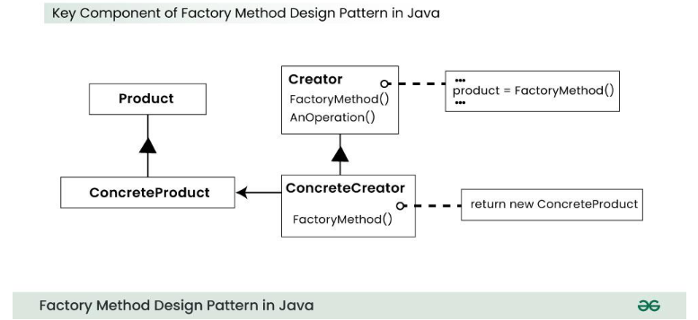
Key Components of Factory Method Design Pattern

Slide 5
Product
It’s an abstract class or interface that defines the common operations for the objects that the factory will create.
Concrete Products are the actual classes that implement the Product interface, each representing a specific type of object to be created.
Creator
It’s an abstract class or interface that declares the factory method.
This method is responsible for creating Product objects, but it delegates the actual creation to subclasses.

Slide 6
Concrete Creators
These are subclasses of the Creator that implement the factory method.
They decide which specific Concrete Product to create, often based on input parameters or configuration.
Factory Method
It’s a method defined in the Creator class that is responsible for creating Product objects.
It’s typically declared as abstract in the Creator and implemented in the Concrete Creators.

Slide 7
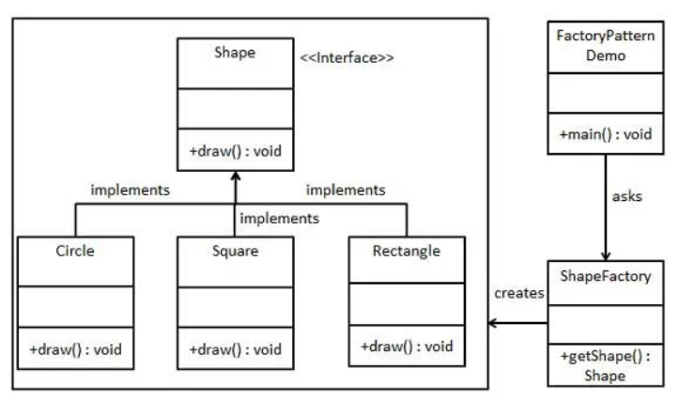

Slide 8
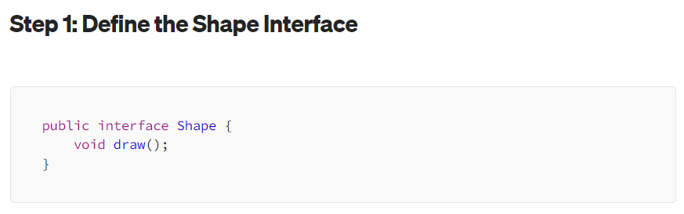

Slide 9
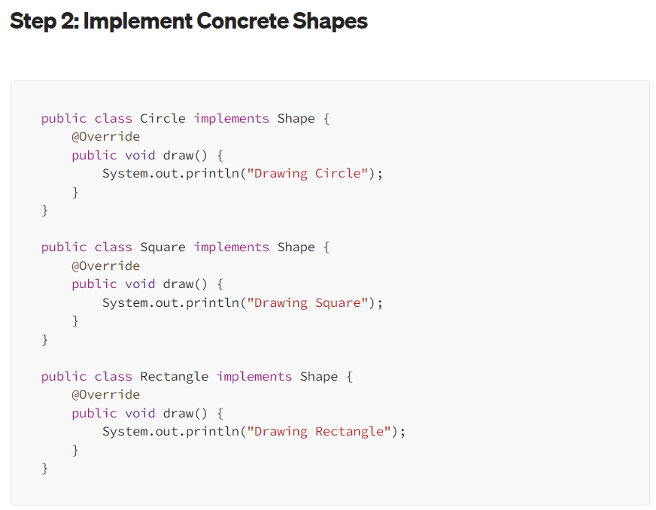

Slide 10
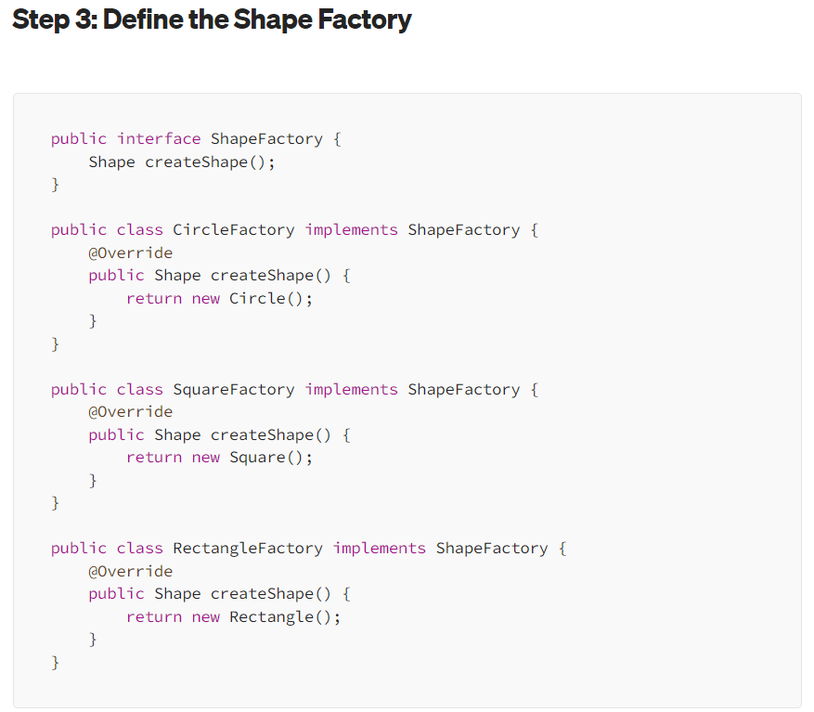

Slide 11
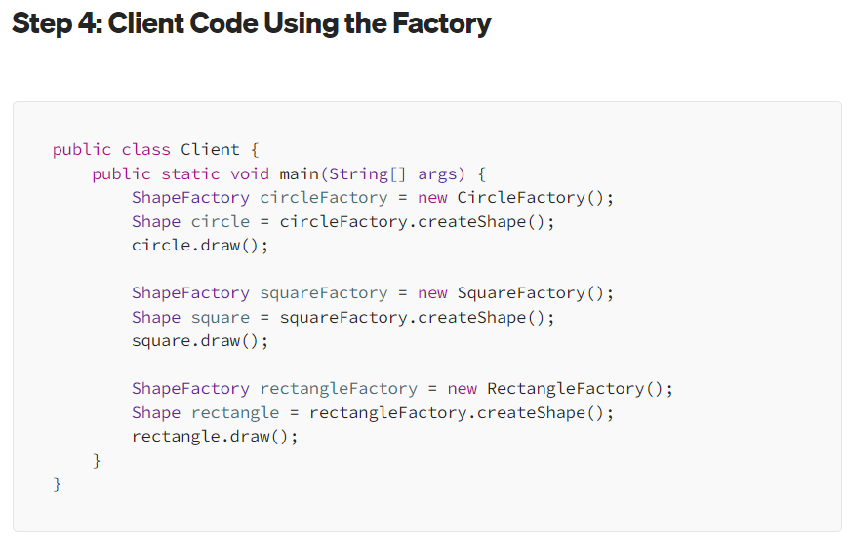

Slide 12
